Slide 1
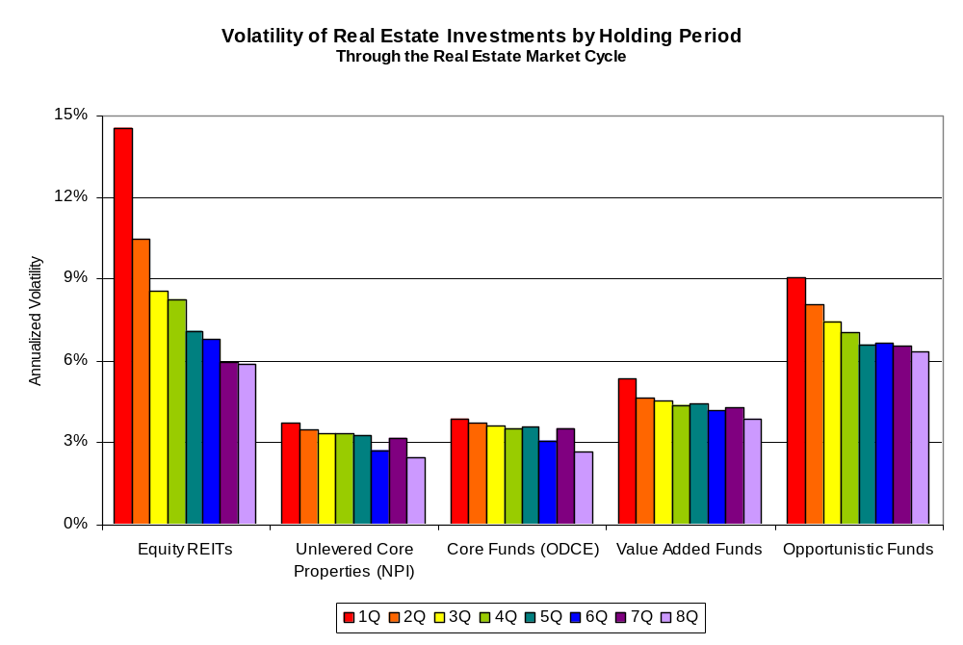
Volatility Declines as Holding Periods Increase
Much More Dramatically for Publicly Traded REITs
Note: Data are for the full real estate market cycle, peak to peak: 1989Q3-2007Q1 for publicly traded REITs (FTSE NAREIT All Equity REITs Index); 1990Q3-2008Q2 for unlevered core properties (NCREIF Property Index) and core funds (Open-End Diversified Core Equity Funds Index); 1990Q3-2008Q1 for value-added funds (NCREIF/Townsend Fund Indices); and 1990Q3-2007Q4 for opportunistic funds (NCREIF/Townsend Fund Indices). Source: NAREIT analysis of data from NCREIF and FTSE NAREIT Equity REITs Index.

